Slide 1
BOOK RECOMMENDER
SYSTEM

Slide 2
ABSTRACT
A book recommender system is a type of information ﬁltering system designed to suggest books to users based on their preferences, interests, and past interactions with the system. The goal of such a system is to provide personalized recommendations that help users discover books they are likely to enjoy, thereby enhancing their reading experience and engagement with the platform.

Slide 3
INTRODUCTION
The system incorporates various algorithms, including user-based and item-based collaborative ﬁltering, content-based ﬁltering, and hybrid approaches, to effectively capture the diverse preferences of users and recommend books that match their unique tastes. Key components of the proposed system include data collection and preprocessing, user proﬁling, recommendation generation, and evaluation metrics. The system collects user interaction data, such as ratings, reviews, and browsing history, to build comprehensive user proﬁles that reﬂect their reading preferences and behavior.

Slide 4
Problem Statement
The current book recommendation systems often fall short in providing accurate and personalized suggestions. Users encounter issues such as irrelevant recommendations, limited genre diversity, and inadequate user engagement. To address these challenges, our project seeks to develop a comprehensive solution that optimizes the recommendation process and ensures a more satisfying user experience.

Slide 5
OBJECTIVE
The primary objective of this project is to design, develop, and implement a Book Recommender Database Management System that signiﬁcantly improves the accuracy and personalization of book recommendations. By leveraging advanced data management techniques, machine learning algorithms, and user interaction analytics, the system aims to address the shortcomings of existing platforms and provide users with a seamless, tailored, and engaging experience in discovering literature. The ultimate goal is to create a dynamic recommendation system that continually adapts to user preferences, fostering a more satisfying and enjoyable reading journey for individuals with diverse tastes.

Slide 6
Domain and Technical Approach
The project falls within the domain of information retrieval, data management, and recommendation systems. Our technical approach involves the implementation of a robust database architecture, machine learning algorithms, and user interaction analytics. By combining these elements, we aim to create a seamless integration of technology and literature, providing users with a novel and enjoyable way to discover books.

Slide 7
OUTCOME
The ultimate outcome of this project is a fully functional Book Recommender Database Management System that sets a new standard for book recommendations. Users can expect a platform that not only recommends books based on their preferences but also adapts and evolves over time. This adaptive nature ensures a continuous improvement in the accuracy and relevance of suggestions, enhancing the overall user experience and promoting a love for reading.

Slide 8
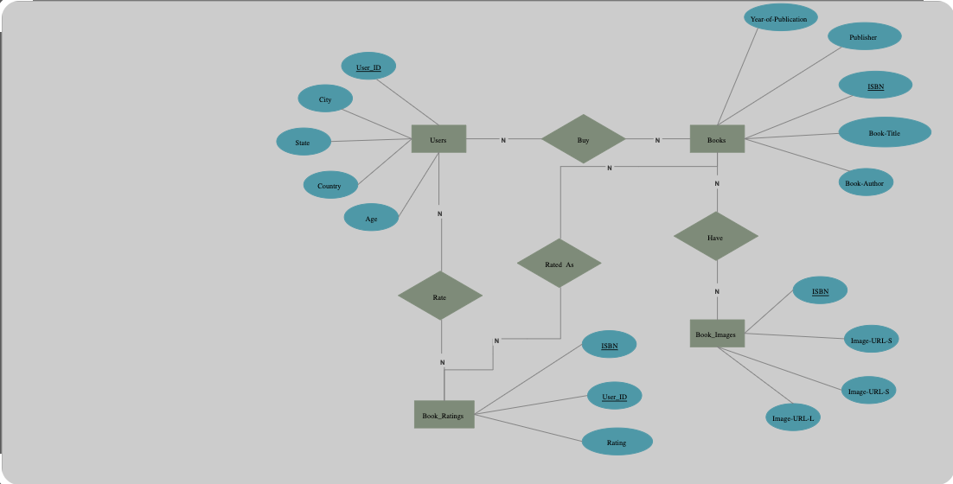
Entity Relationship DIAGRAM:
o
Optimizing resource allocation for increased profitability.

Slide 9
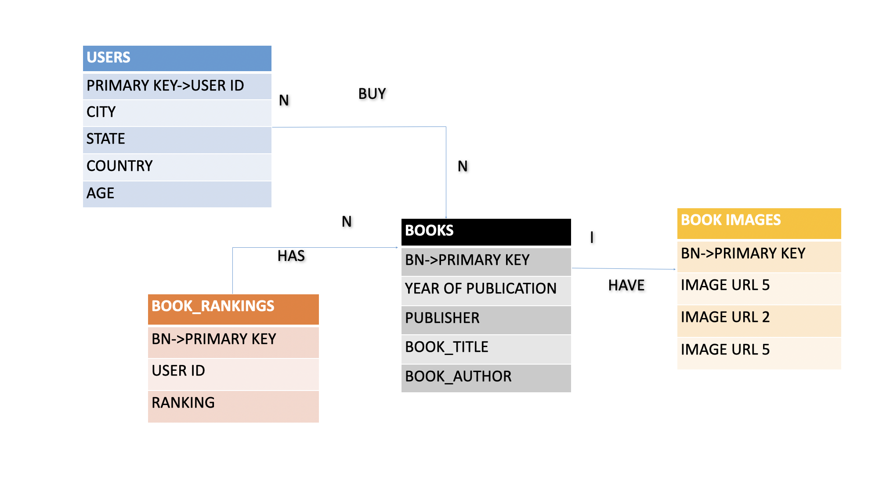
Relational Table for E-R Diagram

Slide 10
Justification for primary key selection
Users Table:
Primary Key (User ID): This is a typical choice for a primary key in a Users table. It is a unique identifier for each user and ensures that each person can be uniquely identified.
Books Table:
Primary Key (Book number): Using a unique identifier for books is essential. The Book Number serves this purpose, allowing for the differentiation of each book.
Book Rankings Table:
Primary Key (Book number , user ID ): Each ranking done by a user should have a unique identifier. These two things provides this uniqueness, helping in and managing individual orders.

Slide 11
THANK YOU
ANAMIKA SAROHA (RA2211026010393)
BRIJESH J (RA2211026010443)

